Slide 1


#3: The Word That Gives Life
‘Before the world was created, the Word already existed… and the Word was life.’ — John 1:1 (GNT)

Slide 2

The Field of Morning Breath
When we open the Bible, God breathes out—We breathe Him in.”

Slide 3
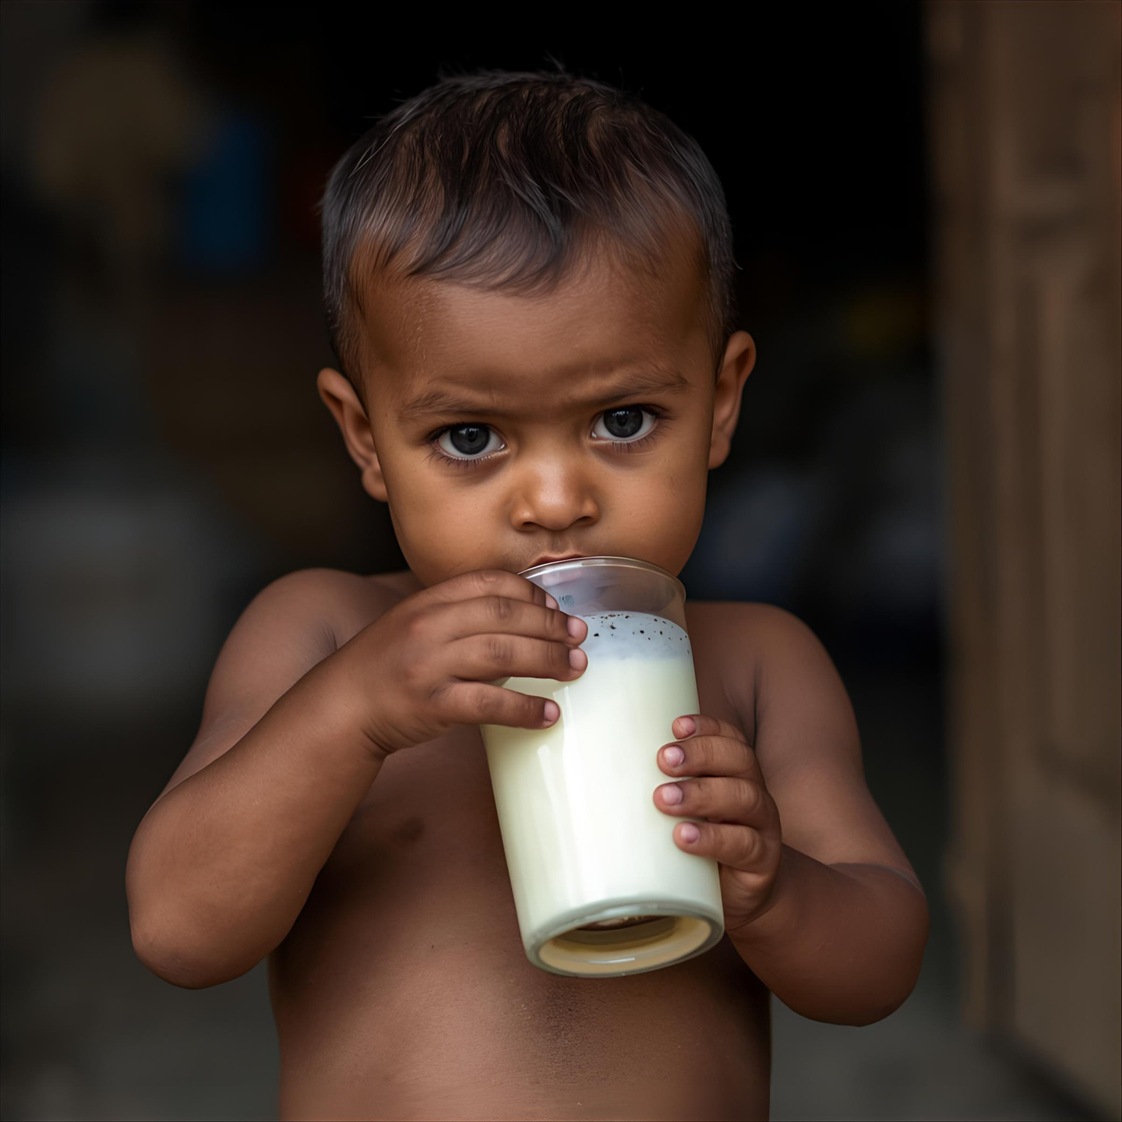
Milk: Learning to Grow
Be like newborn babies, always thirsty for the pure spiritual milk.’ — 1 Peter 2:2–3 GNT

Slide 4

Bread: Strength for the Journey
The Word is Bread — strength for my spirit.
‘Man cannot live on bread alone…’ — Matthew 4:4 GNT

Slide 5
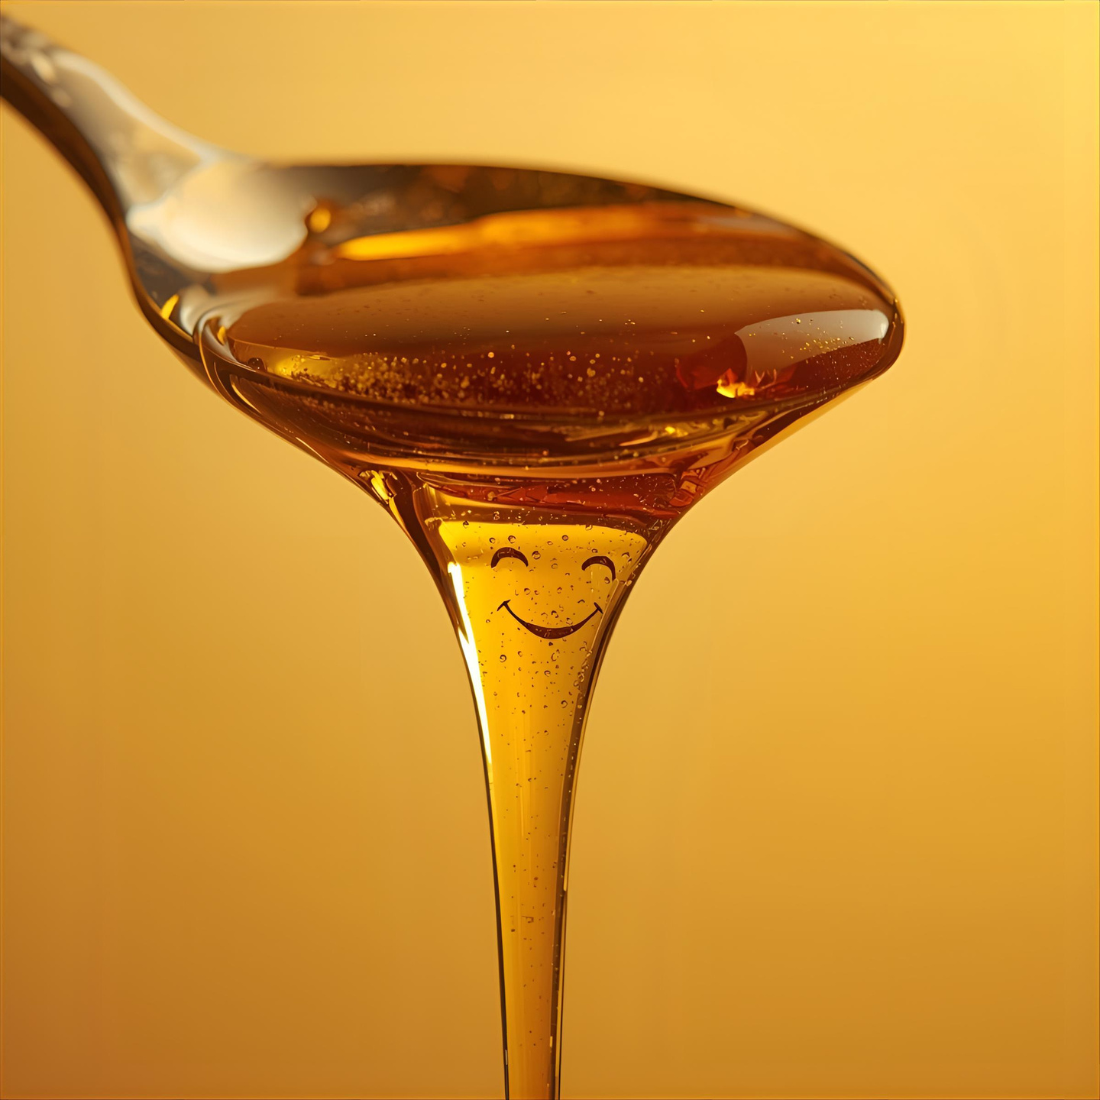
Honey: Sweet in Hard Times
The Word is Honey — sweet joy in bitter days.
‘How sweet is your promise to me, sweeter than honey!’ — Psalm 119:103 GNT

Slide 6
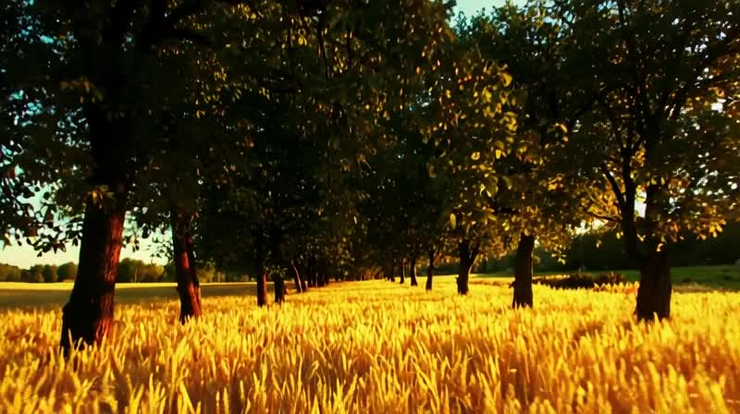
Breath: The Air of God
The Word is Breath — life in every verse.
‘All Scripture is inspired by God.’ — 2 Timothy 3:16 GNT

Slide 7
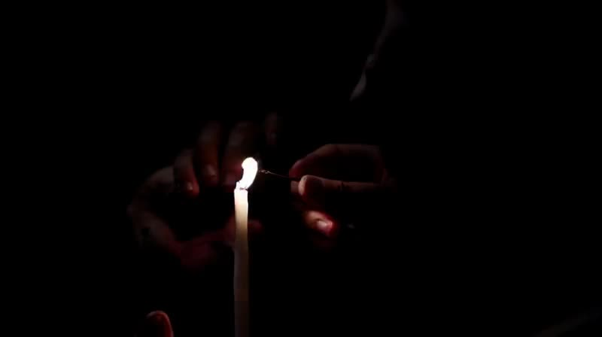
Fire: The Spark in the Heart
The Word is Fire — it lights my spirit.
‘If you remain in me and my words remain in you…’ — John 15:7 GNT

Slide 8

Water: The River That Cleans Within
The Word is Water — it washes and renews me.
‘He made them clean by washing them with water through the word.’ — Ephesians 5:26 GNT

Slide 9

Abiding Word: Jesus Lives in Me
When the Word lives in me, Jesus lives in me.

Slide 10
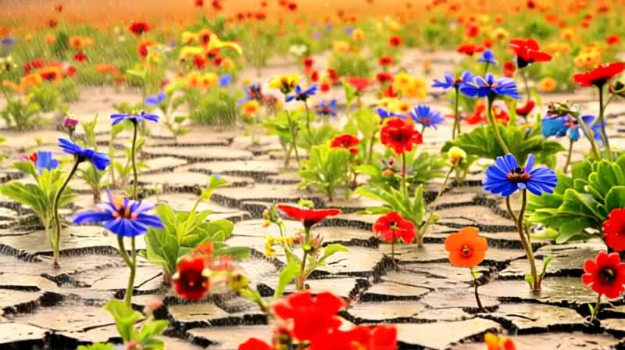
Garden Within: Life Blooms Again
Let the Word rain on your heart until new life grows.”

Slide 11
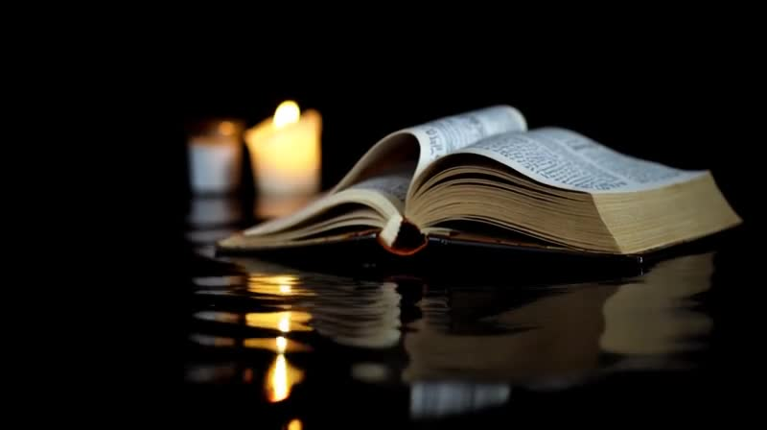
Reflection Moment
Which part of God’s Word do you feel today — Milk, Bread, Honey, Breath, Fire, or Water?

Slide 12
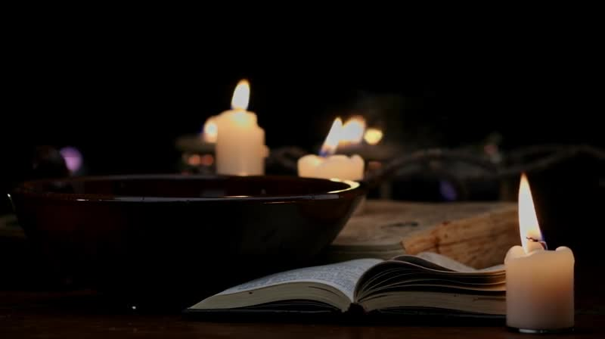
Reflection Moment
How does His Word bring you life?

Slide 13

Commitment Prayer
“Lord Jesus, Your Word is milk when I am weak, bread when I am hungry, honey when I am sad, breath when I am tired, fire when I am cold, and water when I am dry. Live in me through Your Word. Wash me, feed me, and light my heart again. Amen.”

Slide 14
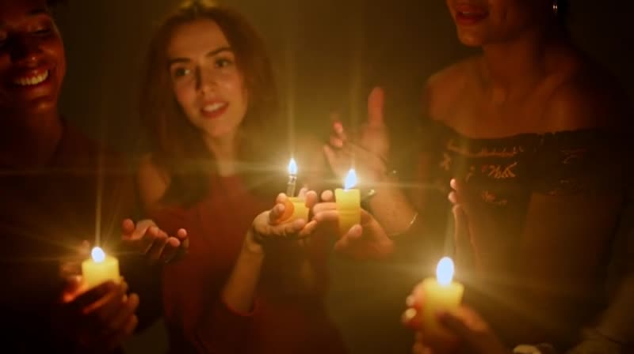
Closing Blessing
You have eaten God’s Word tonight. Let it grow in you and shine through your hands.
“The Word gives life — every day, in every heart.”

